Slide 1
Processes and Threads

Slide 2
Process is like a started program
Own memory (Address space, stack, heap, etc.)
Own File descriptors (file, network)
Own File System Context
Own Signal handling
To communicate they use Inter Process Communication (IPC)
e.g. sockets, pipes, files (due to no shared memory)
I.E. totally independent from other processes

Slide 3
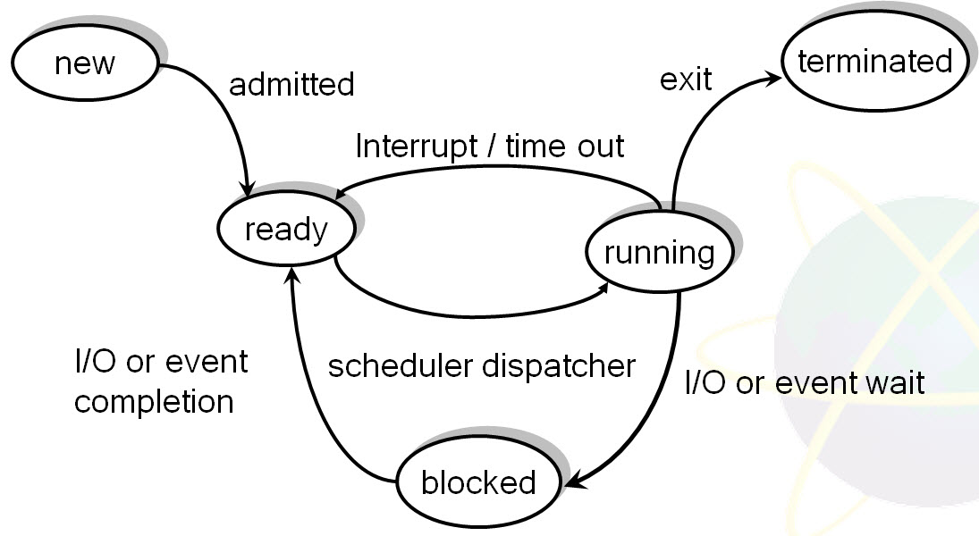
Life Cycle of a Process

Slide 4
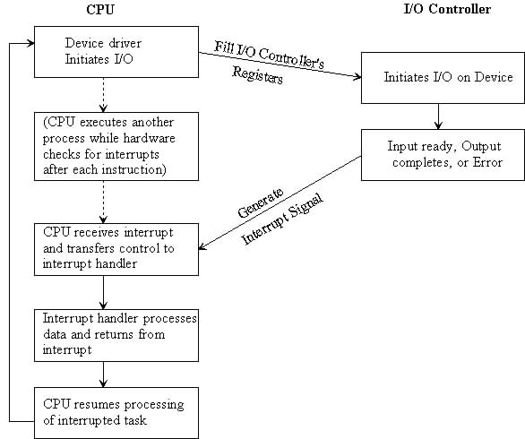
I/O interrupt handling

Slide 5
Split process in independent tasks
Don’t like to wait (e.g. on I/O)
Solution create ‘small’ or lightweight’ processes => threads
inside / internally in a process
Use all hardware i.e. if you have 4 core
-> why not split your process into 4 threads

Slide 6
Thread is a lightweight process
Share memory (Address space, stack, heap, etc.)
Share File descriptors (file, network)
Share File System Context
Share Signal handling
To communicate they use either
  Shared memory
  Inter Process Communication (IPC) e.g. sockets, pipes, files
I.E. All threads from same process are dependent

Slide 7
How to make Thread in c#
Make a method (e.g. DoWork) to run in the thread
must be without parameter
Make an object of ThreadStart – class
pass the method above in the constructor
Make an object of Thread – class
pass the object (ThreadStart) above in the constructor
Call the Start on the thread-object

Slide 8
Example – the most simple
namespace xyz{
public class ThreadTest{
public static void Main(String[] args){
Thread t = new Thread (new ThreadStart(DoWork));
t.Start();
}
void DoWork(){
// do the work
// e.g. some loop – for(int i; i<10; i++)
}
}
} // namespace

Slide 9
Some Links:
General
  http://msdn.microsoft.com/en-us/library/windows/desktop/ms684841(v=vs.85).aspx
  http://www.programmerinterview.com/index.php/operating-systems/thread-vs-process/
  http://en.wikipedia.org/wiki/Thread_(computing)
  http://en.wikipedia.org/wiki/Process_(computing)
  http://www.cs.berkeley.edu/~istoica/classes/cs194/05/notes/4-ProcThread.pdf
C# way
  http://www.albahari.com/threading/
  http://www.youtube.com/watch?v=G7XW7wylSLs

